Slide 1

LLM PER SO ESPERIMENTO 1.0 (ES.5 + Distribuzione es4)
Tesi di laurea magistrale in Software Security
Andrea Esposito, M63001650
(20/04/2026)

Slide 2
Esempio di risultato (dynamic_failure):
student | exercise | commit_analyzed | failurte_category | compile_success | test_success | stdout | stderr | test_feedback | program_output | static_warnings | llm_output_correct | llm_output_diagnosis | llm_code_correct | llm_code_diagnosis | judge_output_correct + judge_Output_Motivation | judge_code_correct + judge_Code_Motivation
prezi0sa03 | un_primo_esempio_di_server_multithread | ad75d4997439208955f5fd1ab745aa3ab72ebeb5 | dynamic_failure | true | false | fail |  | Esercizio primo esempio di server multithreadL'esercizio non è ancora stato svolto correttamente.L'esecuzione non è corretta: Il valore del messaggio di risposta non corrisponde agli operandi del messaggio di richiesta. | Richiesta 0 Inviata (78, 83) [PID=2395505]\n\nRisposta 0 Ricevuta (78) [PID=2395505] CONTINUA)… | { "file":"Client.c", "line": 64, "message": «E’ richiesto che il client effettui una receive selettiva, utilizzando il PID nel campo tipo dei messaggi di risposta." }, {"file": "Server.c", "line": 45, "message": «E’ richiesto che il mutex sia definito e inizializzato fuori dal ciclo while(1){...} del server. Si suggerisce di dichiarare una variabile globale di tipo pthread_mutex_t, e di inizializzarla subito prima del ciclo tramite pthread_mutex_init()." } | NO | The responses do not match the expected protocol semantics. Each response should return the product of the two integers sent in the corresponding request, but the responses consistently return only the first integer of the pair. This is a visible mismatch in the request/reply protocol and violates the exercise's requirement for the server to compute and return the product. | NO | In FILE: Client.c, the msgrcv call at line 45 does not specify the msgtyp parameter to filter messages by the client's PID. This violates the protocol requirement that clients must receive responses specific to their PID. Without this filter, a client may incorrectly receive a response intended for another client, leading to protocol mismatches. The correct usage should include the PID as the msgtyp parameter to ensure proper message association. | YES, The diagnosis correctly identifies that the responses do not match the expected values derived from the request, which aligns with the ground truth stating that the response values do not correspond to the request operands. The diagnosis provides a more detailed explanation of the mismatch but remains semantically aligned with the ground truth failure category. | YES, The diagnosis correctly identifies the same defect mechanism as the ground truth warning in Client.c:64. Both point out the need for selective message reception using the PID in the msgtyp parameter to comply with the protocol. The diagnosis provides a detailed explanation of the issue and its consequences, which aligns with the ground truth's requirement for selective receive. The Server.c warning is unrelated to the diagnosis and does not affect its correctness.

Slide 3
Esempio di risultato (timeout):
student | exercise | commit_analyzed | failurte_category | compile_success | test_success | stdout | stderr | test_feedback | program_output | static_warnings | llm_output_correct | llm_output_diagnosis | llm_code_correct | llm_code_diagnosis | judge_output_correct + judge_Output_Motivation | judge_code_correct + judge_Code_Motivation
valeannu | remote_procedure_call | 949114e9b82feb9838ca9efe9310937f4798557d | timeout | true | false | fail |  | Esercizio remote procedure call. L'esercizio non è ancora stato svolto correttamente. L'esecuzione del programma è andata in timeout | (CONTINUA)…Errore, tipo di richiesta sconosciutatimeout: sending signal TERM to command ‘./start’ | { "file": "server.c", "line": 71, "message": «E’ richiesto che la struttura dati con i parametri del thread worker venga deallocata dallo heap, utilizzando free()." } | NO | The output shows a timeout at the end, indicating incomplete execution. Additionally, there is a visible error \"Errore msgsnd: Invalid argument,\" suggesting a failure in message sending. The trace also shows an unknown request type error and inconsistent operation counts: the expected 3 produci and 3 consuma operations are not fully visible. The immediate reply for PRODUCI CON SOMMA returns 0, which contradicts the expected sum result. These issues indicate protocol violations, incomplete pairing, and incorrect values. | NO | In FILE: server.c, the pthread_create call at line 61 incorrectly frees the struct param pointer p immediately after creating the thread. This causes a lifetime issue because the worker thread may still access the freed memory, leading to undefined behavior. The struct param should remain valid for the duration of the thread's execution. The premature free(p) violates the ownership/lifetime invariant for thread arguments. | YES, The diagnosis aligns with the ground truth by identifying a timeout and incomplete execution, which are explicitly mentioned. The additional details about protocol violations, errors, and inconsistencies enrich the generic ground truth without contradicting it. These are plausible symptoms of the same failure category (execution not completed correctly). | YES, The diagnosis correctly identifies the same defect mechanism as the ground truth. Both point to the improper handling of the struct param memory, specifically its premature deallocation, which violates the lifetime requirements for thread arguments. The diagnosis provides a detailed explanation of the root cause, which aligns with the ground truth's warning about the need to manage the deallocation properly. The causal chain is sound and within the same defect family (lifetime management).

Slide 4
Esempio di risultato (dynamic_failure):
student | exercise | commit_analyzed | failurte_category | compile_success | test_success | stdout | stderr | test_feedback | program_output | static_warnings | llm_output_correct | llm_output_diagnosis | llm_code_correct | llm_code_diagnosis | judge_output_correct + judge_Output_Motivation | judge_code_correct + judge_Code_Motivation
chia-me | remote_procedure_call | 262d99f3d29992606d89b32c0edd36d04185d0c2 | dynamic_failure | true | false | fail |  | Esercizio remote procedure call. L'esercizio non è ancora stato svolto correttamente.L'esecuzione non è corretta: Errore nel valore di PRODUCI CON SOMMA ricevuto dal server\nIl numero totale di messaggi non corrisponde a quello richiesto dalla traccia | [Produttore] Chiamo PRODUCI CON SOMMA(4, 8, 8)\n[Client] Invio richiesta PRODUCI_CON_SOMMA(4, 8, 8) (CONTINUA)… | { "file": "server.c", "line": 71, "message": «E’ richiesto che la struttura dati con i parametri del thread worker venga deallocata dallo heap, utilizzando free()." } | NO | The immediate replies to PRODUCI_CON_SOMMA and PRODUCI requests return placeholder values (risultato=0), which contradict the semantic expectation of computed results. The correct values (e.g., 20 for PRODUCI_CON_SOMMA) only appear later in CONSUMA replies, indicating a visible mismatch in request/reply association. This violates the RPC protocol, where each request should receive a meaningful immediate reply. | NO | In FILE: server.c, function worker, the struct param* code is shared among all worker threads without synchronization, leading to a race condition. Each thread accesses code->id_coda_richieste and code->id_coda_risposte concurrently (lines 73-74), but no mutex or thread-local copy is used to protect these accesses. This violates the synchronization policy for shared resources and can cause threads to read inconsistent or corrupted values. | YES, The diagnosis identifies a mismatch in request/reply association and placeholder values, which aligns with the ground truth's mention of incorrect execution and an error in the value of PRODUCI CON SOMMA. Both point to a failure in the output's correctness, specifically related to values and protocol adherence. The diagnosis enriches the generic ground truth without contradicting it. | NO, The ground truth warning pertains to the deallocation of the struct param object (code) from the heap using free(), which is a lifetime management issue. The diagnosis, however, identifies a race condition due to unsynchronized access to shared fields of the struct param object (code->id_coda_richieste and code->id_coda_risposte), which is a synchronization issue. These are distinct defect families, and the diagnosis does not address the lifetime management issue described in the ground truth.

Slide 5
Esempio di risultato (static_failure):
student | exercise | commit_analyzed | failurte_category | compile_success | test_success | stdout | stderr | test_feedback | program_output | static_warnings | llm_output_correct | llm_output_diagnosis | llm_code_correct | llm_code_diagnosis | judge_output_correct + judge_Output_Motivation | judge_code_correct + judge_Code_Motivation
amezak1 | un_primo_esempio_di_server_multithread | eb3316a2bd3d9354d2aecd8e4c45d9aeb57f3f4d | static_failure | true | false | fail |  | Esercizio primo esempio di server multithreadL'esercizio non è ancora stato svolto correttamente. Anche se il programma esegue, sono stati riscontrati i seguenti difetti all'interno del codice (Server.c) | Richiesta 0 Inviata (62, 17) [PID=2230209]\n\nRisposta 0 Ricevuta (1054) [PID=2230209]\n\nRichiesta 1 Inviata (26, 67) [PID=2230209](CONTINUA)… | { "file": "Server.c", "line": 41, "message": "\u00c8 richiesto che il mutex sia definito e inizializzato fuori dal ciclo while(1){...} del server. Si suggerisce di dichiarare una variabile globale di tipo pthread_mutex_t, e di inizializzarla subito prima del ciclo tramite pthread_mutex_init()." } | YES | No concrete output mismatch is visible. The trace shows consistent request/reply pairing for all clients, with correct arithmetic results for the product of the two integers in each request. The counts of requests and replies match the expected protocol (5 requests and replies per client, 3 clients total). The server termination phase is not explicitly shown but does not affect the correctness of the visible interactions. | NO | FILE: server.c, function Prodotto, lines 86-101: The mutex pthread_mutex_t mutex is initialized inside the worker thread function Prodotto at line 86. This violates the synchronization policy because the mutex is re-initialized for each thread instead of being initialized once globally. This results in each thread using a separate mutex, which fails to enforce mutual exclusion on the shared resource id_coda_risposte during msgsnd(...) at line 94. The mutex should be initialized once globally in the main server function to ensure proper synchronization across all threads. | YES, The diagnosis correctly states that no concrete output mismatch is visible and aligns with the ground truth, which confirms the visible execution/output is correct. It does not invent any additional problems or contradict the ground truth. | YES, The diagnosis correctly identifies the same underlying defect mechanism as the ground truth warning: the improper initialization of the mutex within the worker thread function instead of globally, which violates synchronization requirements. The diagnosis provides additional details about the consequences (failure to enforce mutual exclusion) but remains within the same defect family and does not contradict the ground truth.

Slide 6
Esempio di risultato (static_failure):
student | exercise | commit_analyzed | failurte_category | compile_success | test_success | stdout | stderr | test_feedback | program_output | static_warnings | llm_output_correct | llm_output_diagnosis | llm_code_correct | llm_code_diagnosis | judge_output_correct + judge_Output_Motivation | judge_code_correct + judge_Code_Motivation
CryptoGionni | server_aggregatore_thread | 08557ac8ccee96209b8600dc2cd9b62681c0fd8b | static_failure | true | false | fail |  | Esercizio server aggregatore con thread L'esercizio non è ancora stato svolto correttamente. Anche se il programma esegue, sono stati riscontrati i seguenti difetti all'interno del codice (aggregatore.c) | Avvio processo collettore (id coda = 6619185)...\nCollettore: In attesa di messaggi...(CONTINUA)… | { "file": "aggregatore.c", "line": 226, "message": «E’ necessario che i lettori possano leggere contemporaneamente il dato condiviso. Si applichi qui l'algoritmo visto a lezione." } | NO | The output shows mismatched values between the sensor and collectors. The sensor generates 10 values, but the collectors receive inconsistent sequences. For example, the sensor sends \"8, 3, 2, 7, 1, 0, 2, 3, 2, 8, \" but collectors receive different sequences, with some values duplicated or missing. This indicates a failure in the forwarding or distribution phase. Additionally, the counts of received values per collector are inconsistent with the expected 10 messages per collector. The visible protocol does not ensure correct pairing, ordering, or completion of the producer/consumer interaction. | NO | FILE: aggregatore.c, function lettura (lines 180-199): The reader-writer synchronization policy is violated. The condition variable VC_SCRITT is signaled (line 197) even when there are active readers (num_lett > 0). This can lead to a writer proceeding while readers are still accessing the shared variable, breaking the reader-writer concurrency requirement. The signal should only occur when no readers are active. | NO, The ground truth states that the visible execution/output is correct, but the diagnosis claims mismatched values, inconsistent sequences, and protocol failures, which contradicts the ground truth. The diagnosis invents problems not present in the output per the ground truth. | YES, The diagnosis identifies a reader-writer synchronization policy violation, which is causally related to the ground truth warning about ensuring readers can read concurrently. Both address the same defect mechanism of improper synchronization in the reader-writer concurrency model.

Slide 7
Esempio di risultato (correct):
student | exercise | commit_analyzed | failurte_category | compile_success | test_success | stdout | stderr | test_feedback | program_output | static_warnings | llm_output_correct | llm_output_diagnosis | llm_code_correct | llm_code_diagnosis | judge_output_correct + judge_Output_Motivation | judge_code_correct + judge_Code_Motivation
ManuelParasmo | un_primo_esempio_di_server_multithread | 006ef42d9d586537e5d1b18d4b5c3c411be92b73 | correct | true | true | pass |  | Esercizio primo esempio di server multithreadCongratulazioni, l'esercizio compila ed esegue correttamente, e non è stato riscontrato nessuno degli errori frequenti nel codice | Richiesta 0 Inviata (36, 32) [PID=2361413]\n\nRisposta 0 Ricevuta (1152) [PID=2361413]\n\nRichiesta 1 Inviata (11, 54) [PID=2361413](CONTINUA)… |  | YES | No concrete output mismatch is visible. The trace shows consistent request/reply interactions for all three clients, with each client sending 5 requests and receiving 5 replies. The computed product values in the replies match the input values in the corresponding requests, and the counts, pairing, and ordering are coherent with the exercise description. | YES | No concrete correctness concrete defect is visible from the provided code and runtime context. The execution output matches the expected behavior described in the exercise, with correct message exchanges and computations. Mutex usage ensures mutual exclusion for the response queue, and all threads handle their tasks correctly." | YES, The diagnosis correctly states that no concrete output mismatch is visible and aligns with the ground truth, which confirms the output is correct. It does not invent any additional problems or contradict the ground truth. | YES, The diagnosis correctly states that no concrete correctness defect is visible, and the observed feedback confirms the code compiles and executes correctly. The diff shows only superficial differences (e.g., variable names, formatting) that do not constitute correctness violations. The diagnosis aligns with the rules and observed feedback.

Slide 8
Analisi effettuate, esercitazione 5
Su un totale di 330 esercizi sono state condotte le seguenti analisi:
Distribuzione per failure category.
Analisi dynamic_failure:
Analisi Output LLM
Analisi Codice LLM
Analisi static_failure:
Analisi Output LLM
Analisi Codice LLM
Analisi corretti:
Analisi Output LLM
Analisi Codice LLM

Slide 9
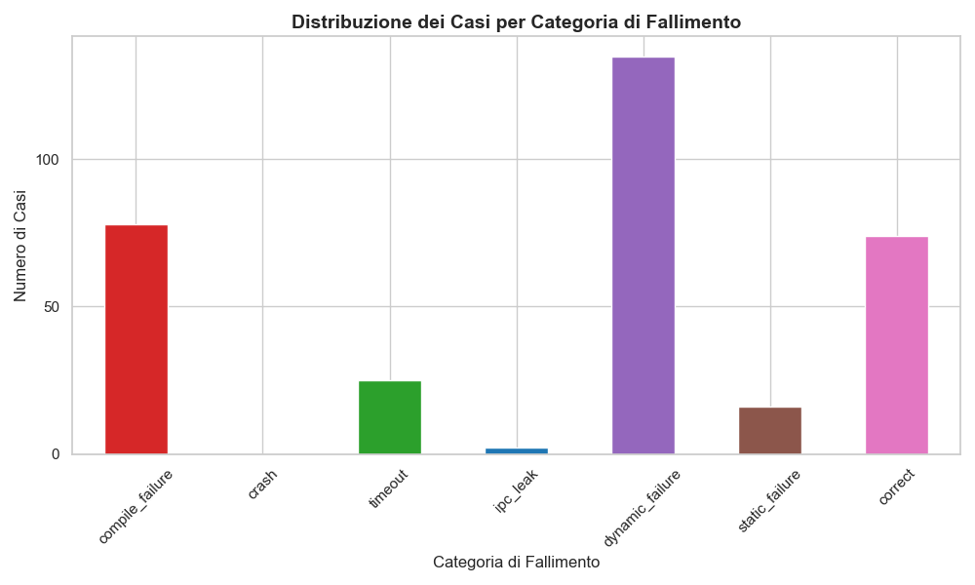
Distribuzione per failure category

Slide 10

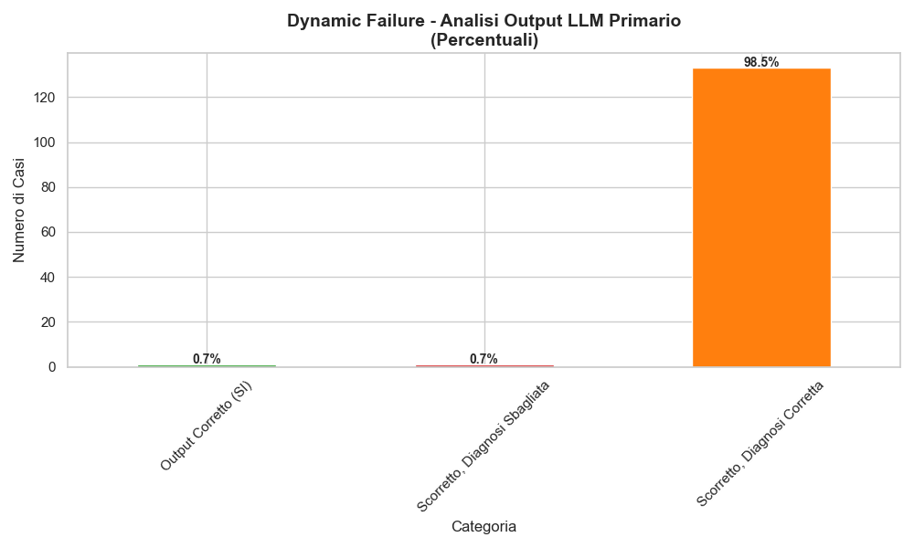
Dynamic Failure - Analisi Output LLM Primario
% LLM primario dice che output è corretto (non trova l'errore).
% LLM primario dice che è scorretto, ma diagnosi output non è corretta.
% LLM primario dice che è scorretto, e la diagnosi output è corretta.

Slide 11
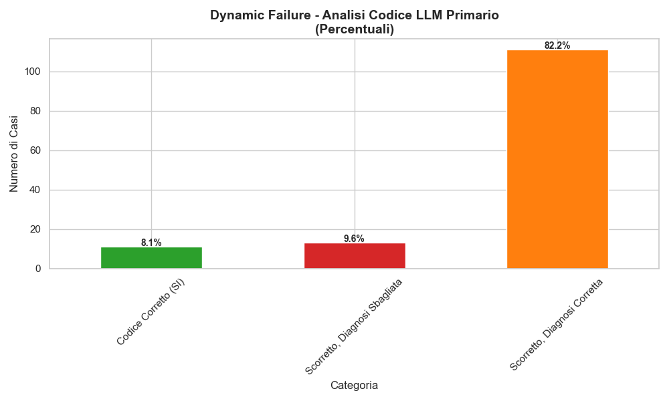
Dynamic Failure - Analisi Codice LLM Primario
% LLM primario dice di non aver trovato l'errore nel codice.
% LLM primario dice che è scorretto, ma diagnosi codice non è corretta.
% LLM primario dice che è scorretto, e la diagnosi codice è corretta.

Slide 12
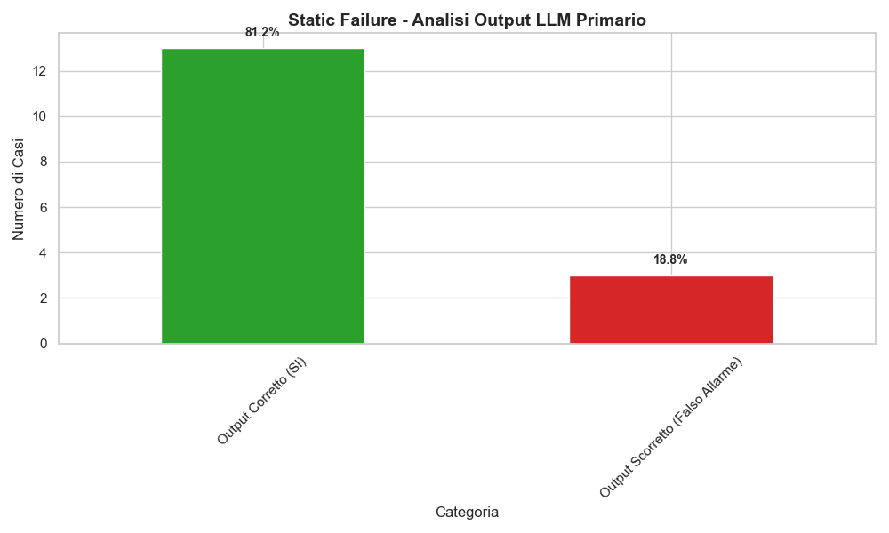
Static Failure - Analisi Output LLM Primario
% LLM primario dice che output è corretto (è ok, si trova con ground truth).
% LLM primario dice che è scorretto (diagnosi è scorretta a prescindere).

Slide 13
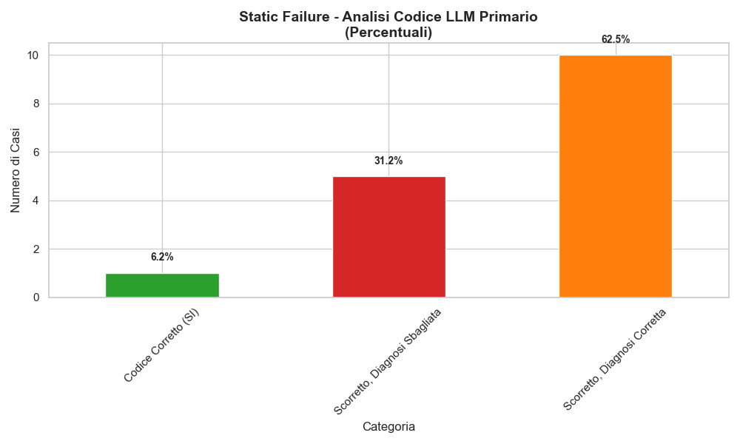
Static Failure - Analisi Codice LLM Primario
% LLM primario dice di non aver trovato l'errore nel codice.
% LLM primario dice che è scorretto, ma diagnosi codice non è corretta.
% LLM primario dice che è scorretto, e la diagnosi codice è corretta.

Slide 14
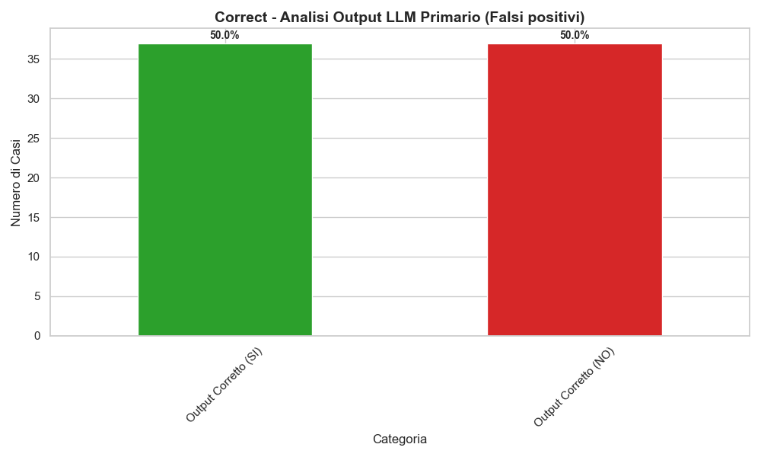
Corretti- Analisi Output LLM Primario (falsi positivi)
% LLM primario dice che output è corretto (è ok, si trova con ground truth).
% LLM primario dice che è scorretto (diagnosi è scorretta a prescindere).

Slide 15
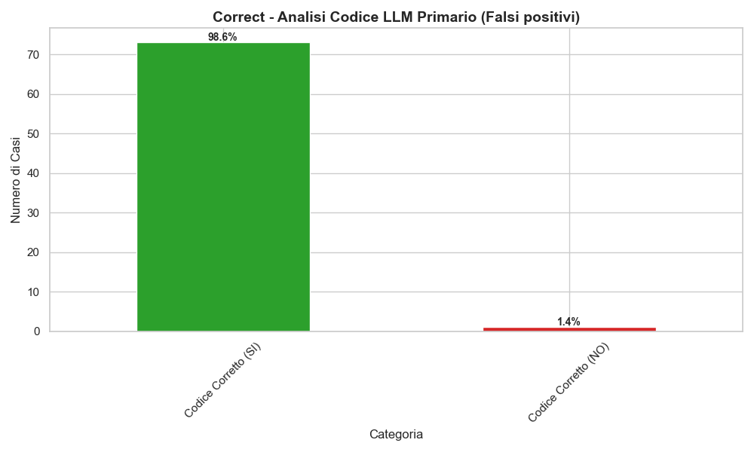
Corretti- Analisi Codice LLM Primario (falsi positivi)
% LLM primario dice che codice è corretto (è ok, si trova con ground truth).
% LLM primario dice che è scorretto (diagnosi è scorretta a prescindere).

Slide 16
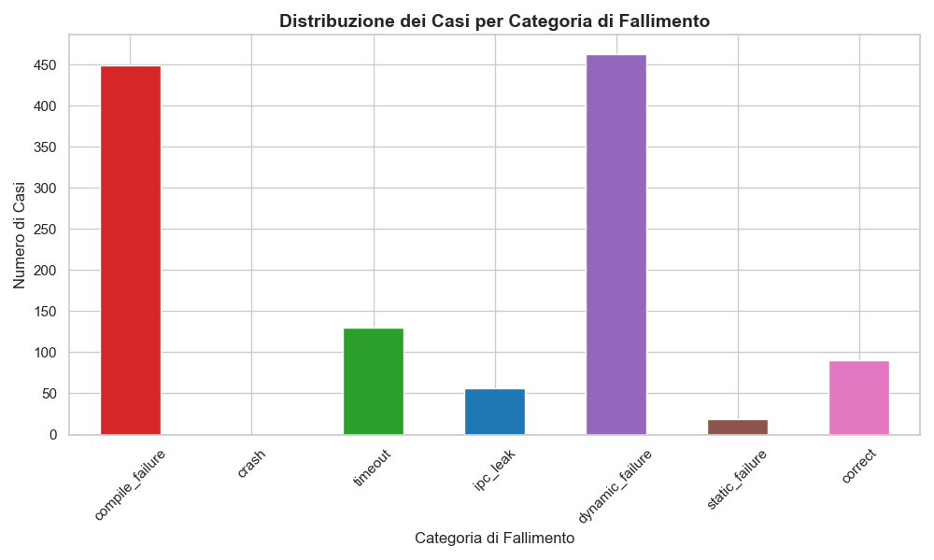
Distribuzione per failure category, tutti commit, esercitazione 4

